Slide 1
Spring JDBC integration
iBatis better than Spring JDBC support, there i just map the SQL with java object. i no need to retrive or pouplate myself. it is done by ibatis. .. But in Spring, in call back implemention, i have write code.

Slide 2
JDBC ( avoid boilerplate code )
Spring with
Ibatis 2.0 ( MyBatis 3.0 )
Hibernate 3.2
JPA 2.0

Slide 3
Elegant Exception handling is common to all persistent layers by template ( its exception hierarchy, unchecked too )
Why
Spring
-JDBC
Use CALLBACK for custom task
We able to configure Datasource as one of bean
Use TEMPLATE for common task
Resource are managed by Template pattern
Convenient DAO support classes

Slide 4
The Advantage of use of DAO support
-----------------------------------------------------
JdbcTemplate and DataSource/ connection can access in our dao without explicitly declared and configured
We get initDao lifecycle method

Slide 5
DataSource or connection obtained
Use JNDI lookup in server
For JEE application
Both JEE / JSE application
Having own pool by DBCP ( apache )
Driver manager connection
------------------------------------
1. DriverManagerDataSource
2. SingleConnectionDataSource
For JSE application

Slide 6
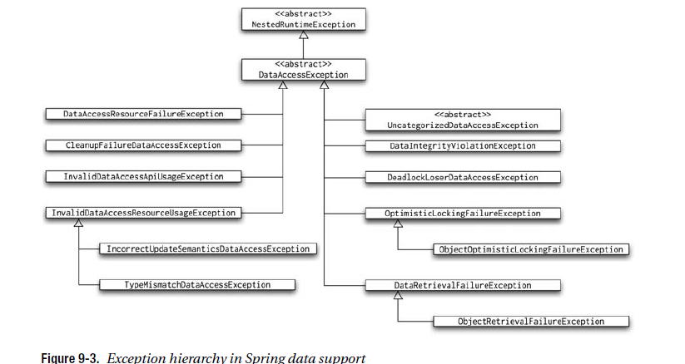

Slide 7
HibernateTemplate
HibernateDaoSupport
JdoTemplate
JdoDaoSupport
JpaTemplate
JpaDaoSupport
JdbcTemplate
JdbcDaoSupport
SimpleJdbcTemplate
SimpleJdbcDaoSupport
RdbmsOperation
As of Spring 3.0 use of hibernate template, jpa template and their DAO is completely optional. I don’t want my DAO use Spring DAO api. So, I wont use.

Slide 8
Spring JDBC can use either of templates
JdbcTemplate
SimpleJDBCTemplate ( it use all Java 5 features)
NamedParameterJDBCTemplate.
RdbmsOperation
(best for master table operations)

Slide 9
About Inner classes
CallableStatementCallback PreparedStatementCallback StatementCallback
( it is generic)
PreparedStatementCreator CallableStatementCreator StatementCreator
( use this when u want to create a
cusstomize statement and may reuse across one or more methods and dao )
PreparedStatementSetter /
BatchPreparedStatementSetter
( use this when u want to set values for a
Prepared statement )
RowCallbackHandler
ResultSetExtractor,
RowCountCallbackHandler
(for generic result processing)
RowMapper and
Its sub interfaces.
( use this or any of its sub interfaces
When we want to create DTO for every row and return the same)

Slide 10
JDBCTemplate ( for tuning )
Fetch size
Max size

Slide 11
JDBCTemplate (select Query )
Query For Map
(single row, many column)
Query for Long
(single row, single column)
Query for List
(Many row, single column)
Query For Object
(single row, many column. (I.e) for single domain DTO)
Query for Object
(single row, single column)
Query for List
(Many row, Many column
(I.e) for many DTO)
Query for Int
(single row, single column)
JDBCTemplate (insert/update/delete Query )
update
batchUpdate
Here update means insert/update/delete
JDBCTemplate ( mostly for PL/SQL execution )
execute
call

Slide 12
iBatis integration
It is configure iBatis and load its configuration file
SqlMapClientFactoryBean
SqlMapClientDaoSupport
Our Dao class should extend this dao support to get access its template and datasource
SqlMapClientTemplate
It has set of method to access inturn QueryService of iBATIS

Slide 13
Hibernate Integration
AbstractSessionFactoryBean
LocalSessionFactoryBean (XML used for mapping)
AnnotationSessionFactoryBean ( Annotation used for mapping )
HibernateDaoSupport
HibernateTemplate (no need to use for 3.5 version onwards because of contextual session)
HibernateCallback

Slide 14
JPA 2.0 Integration
In Sping 3.0, the use JpaTemplate and JpaDaosupport can be AVOIDED by
Use @Repositary and @PersistenceContext annotation.
LocalEntityManagerFactoryBean (for JSE)
LocalContainerEntityManagerFactoryBean ( for JEE )

Slide 15
Spring Transaction

Slide 16
Transaction Attributes
Propagation : REQUIRED ( default), etc.
Isolation : REQUIRED ( default), etc.

Slide 17
Transaction managed in spring in 3 ways
Declaratively (this Transaction achieved in spring by AOP)
Programmatically for more fine-grained boundry
( use of TransactionTemplate)
XML configuration ( need AOP knowledge)
Annotation ( it is easiest, no need of AOP knowledge )

Slide 18
